Slide 1
Flip-flops

Slide 2
outline
D latch, Master-slave FF, FF applications, FF synchronization, Data storage and transfer, Frequency division, and counting, clock pulse generator.
.

Slide 3
D Latch (Transparent Latch)

Slide 4

D Latch
Circuit contains the NAND latch and the steering NAND 1 and NAND 2 without the edge detector circuit. The common input to the steering gates is called an enable input (EN) rather than a clock input because its effect on $Q and \overline{Q}$ outputs is not restricted to occurring only on its transitions.

Slide 5
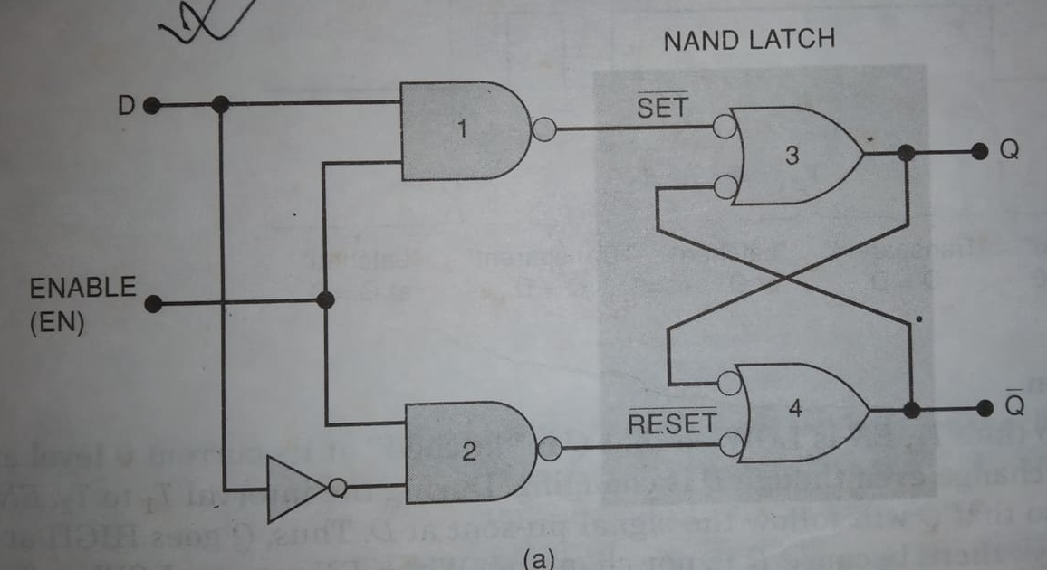
D Latch

Slide 6
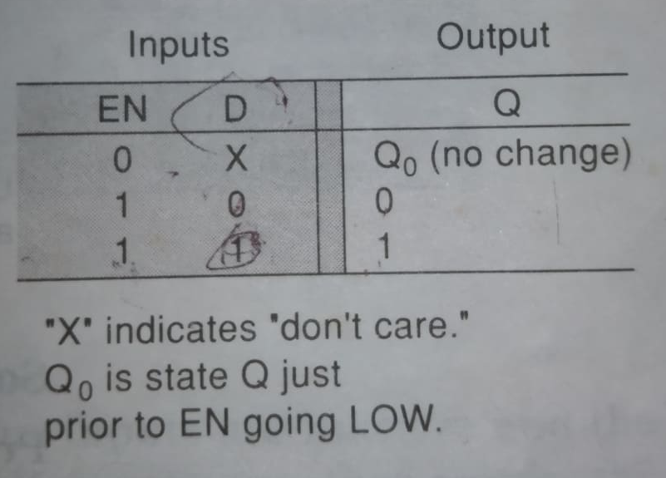
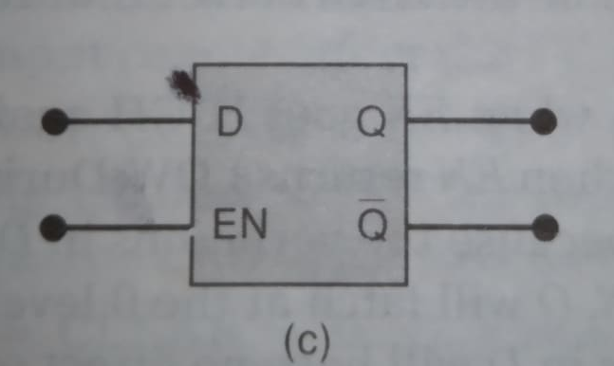
D Latch

Slide 7
D Latch
It has two modes of operation.
Transparent mode
Latch mode
When EN=1, the Q output will look exactly like D. In this mode the D latch is said to be transparent.
When EN=0, the Q output is latched to its current level and cann’t change.
Note: D latch is not edge triggered.

Slide 8
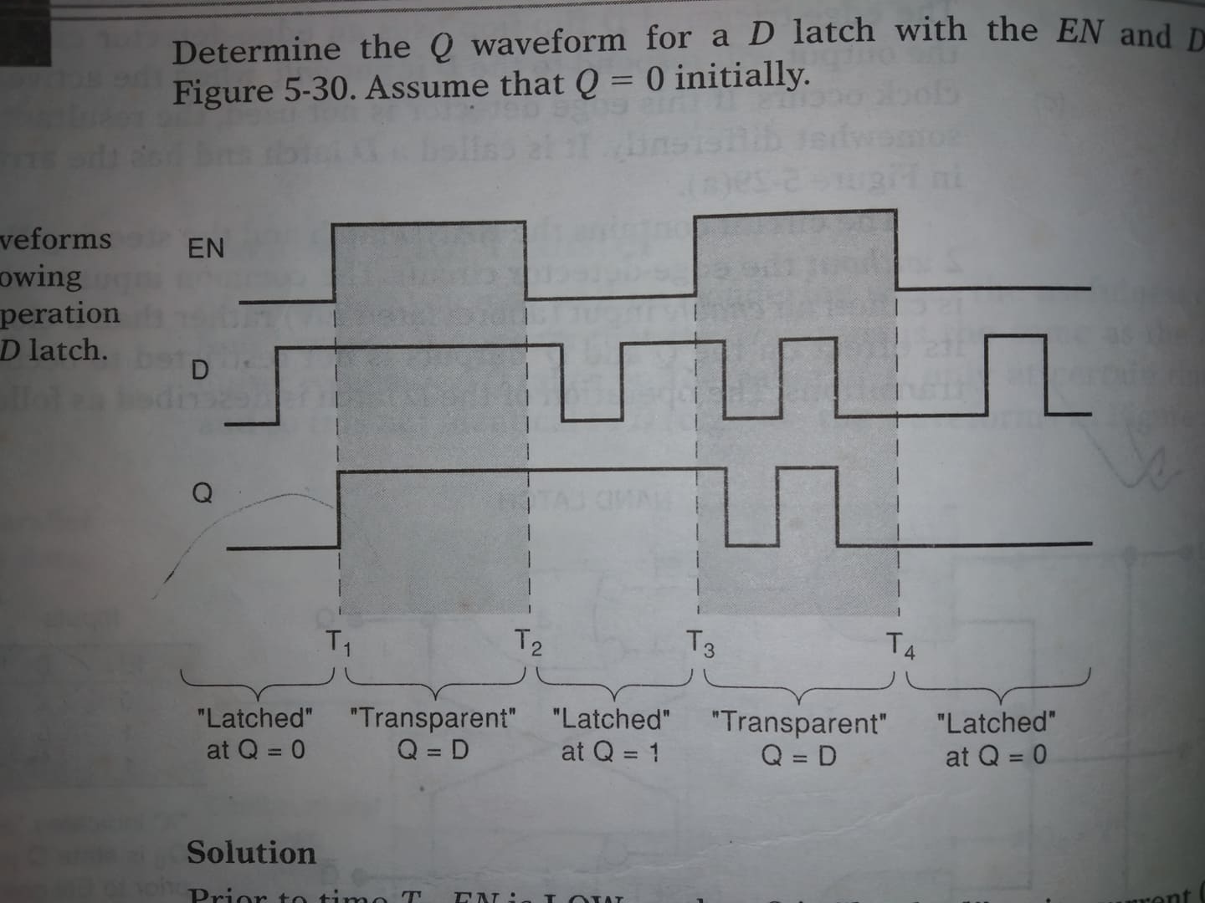
D latch waveform

Slide 9
Master/slave FF

Slide 10

Master-slave FF
Before the development of edge triggered FFs (with little or no hold time requirements) timing problems were often handled by using a class of FFs called master/slave FFs. A master/slave FF actually contains two FFs- master and a slave. On the rising edge of the CLK signal, the levels on the control inputs (D, J, K) are used to determine the output of the master. When the CLK goes LOW the state of the master is transferred to the slave whose outputs are $Q and \overline{Q}$. Thus $Q and \overline{Q}$ change just after the NGT of the clock. Its function is very much like the NGT FFs.
Disadvantage: The control input must be held stable while CLK is HIGH otherwise unpredictable operation may occur.

Slide 11
Ff application
Edge triggered FFs application:
Counting
Storing of binary data
Transferring binary data from one to another or many more location.
Some are categorized as sequential circuits.

Slide 12
Ff synchronization
Most digital systems are principally synchronous in their operation because most of the signals will change states in synchronism with the clock transitions.

Slide 13
Data storage and transfer

Slide 14
Data storage and transfer
The common use of FFs are storage of data and transfer of data. Data represents numerical values such as binary numbers, BCD etc. or wide variety of data that have been encoded in binary.
Data storage: Data are generally stored in a group of FFs called registers.
Data transfer: The operation most often performed on data is the data transfer. Transfer of data from one FF or register to another FF or register. We will see four types of data transfer. 1. synchronous 2. asynchronous 3. parallel 4. serial data transfer.

Slide 15
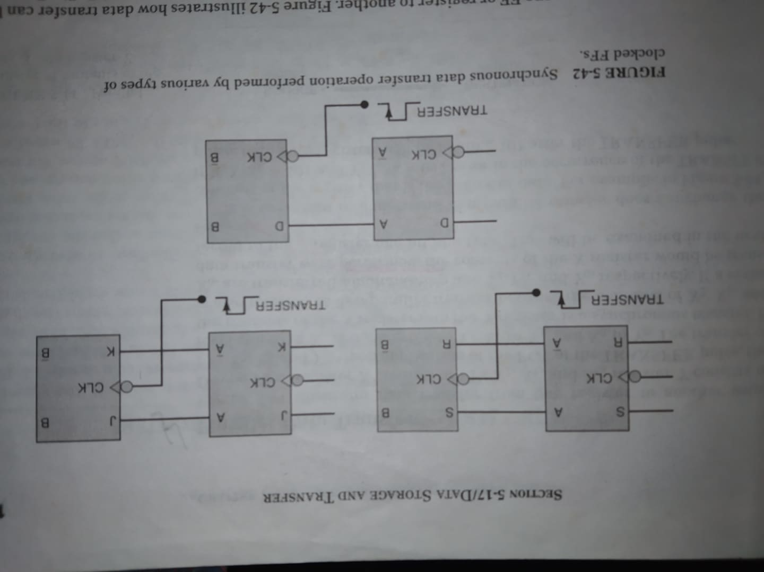
Data storage and transfer (synchronous data transfer)

Slide 16
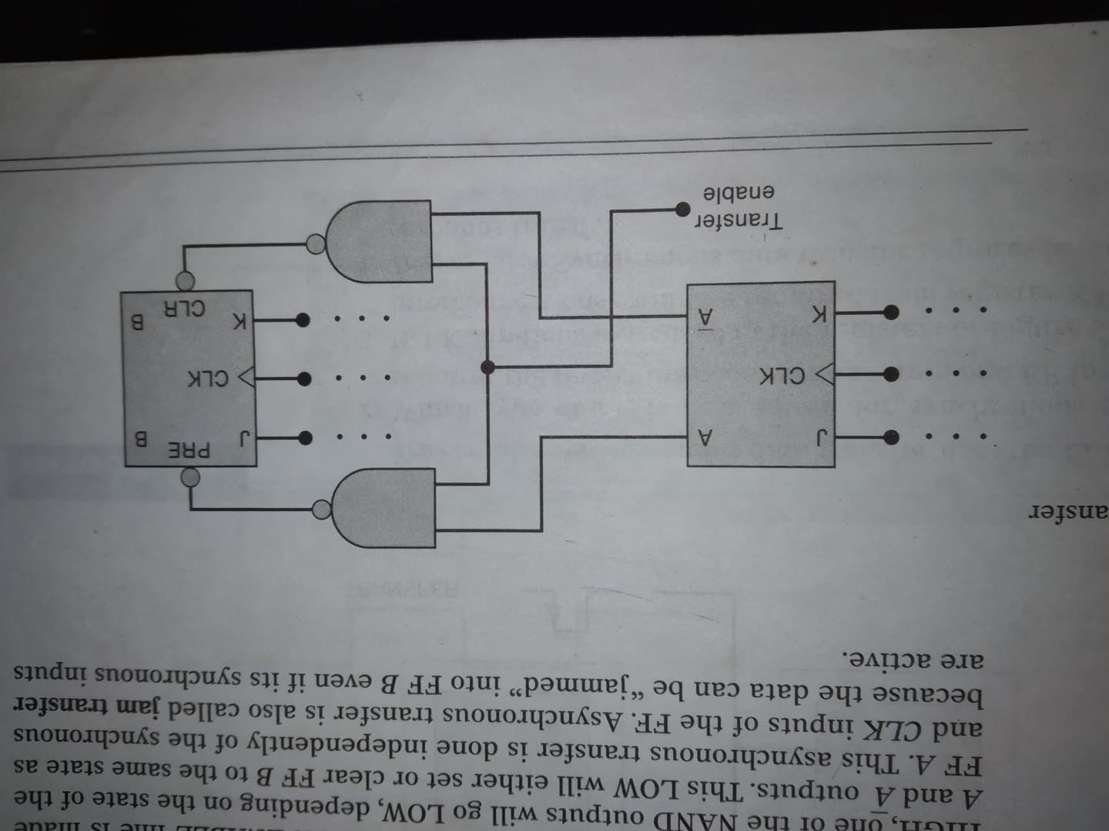
Data storage and transfer (Asynchronous data transfer)
0
1
1
1

Slide 17
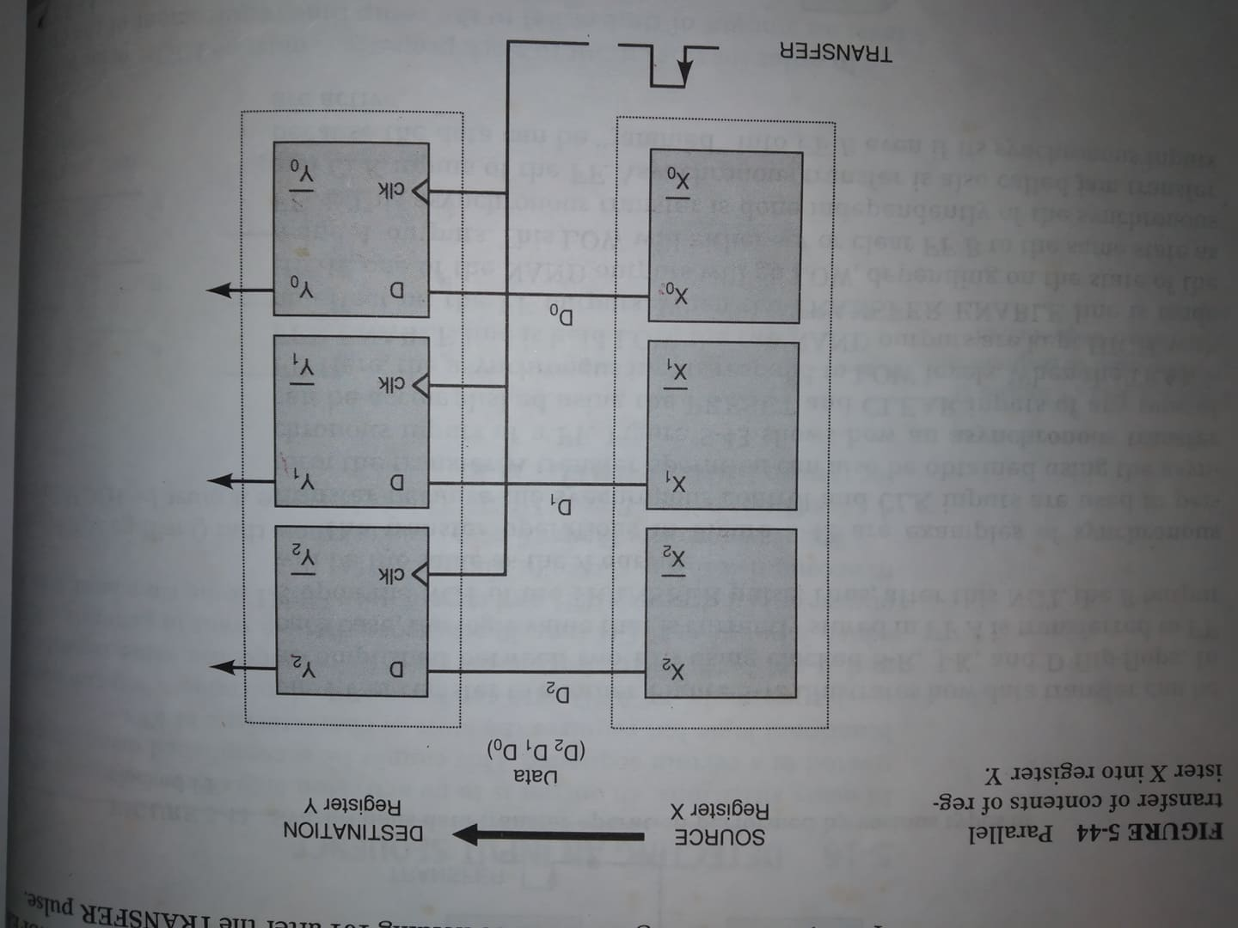
Data storage and transfer (parallel data transfer)

Slide 18
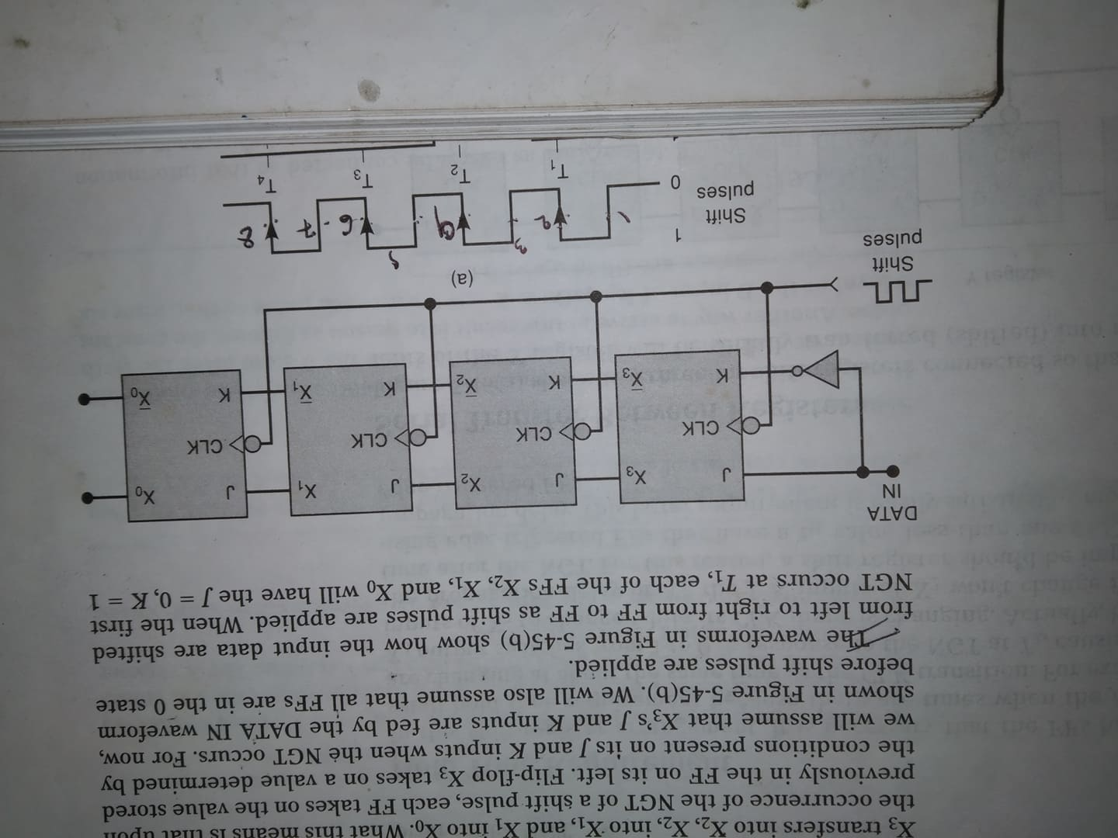
Data storage and transfer (serial data transfer: shift registers)
A shift register is a group of FFS arranged so that the binary numbers stored in the FFs are shifted from one FF to the next for every clock pulse.

Slide 19
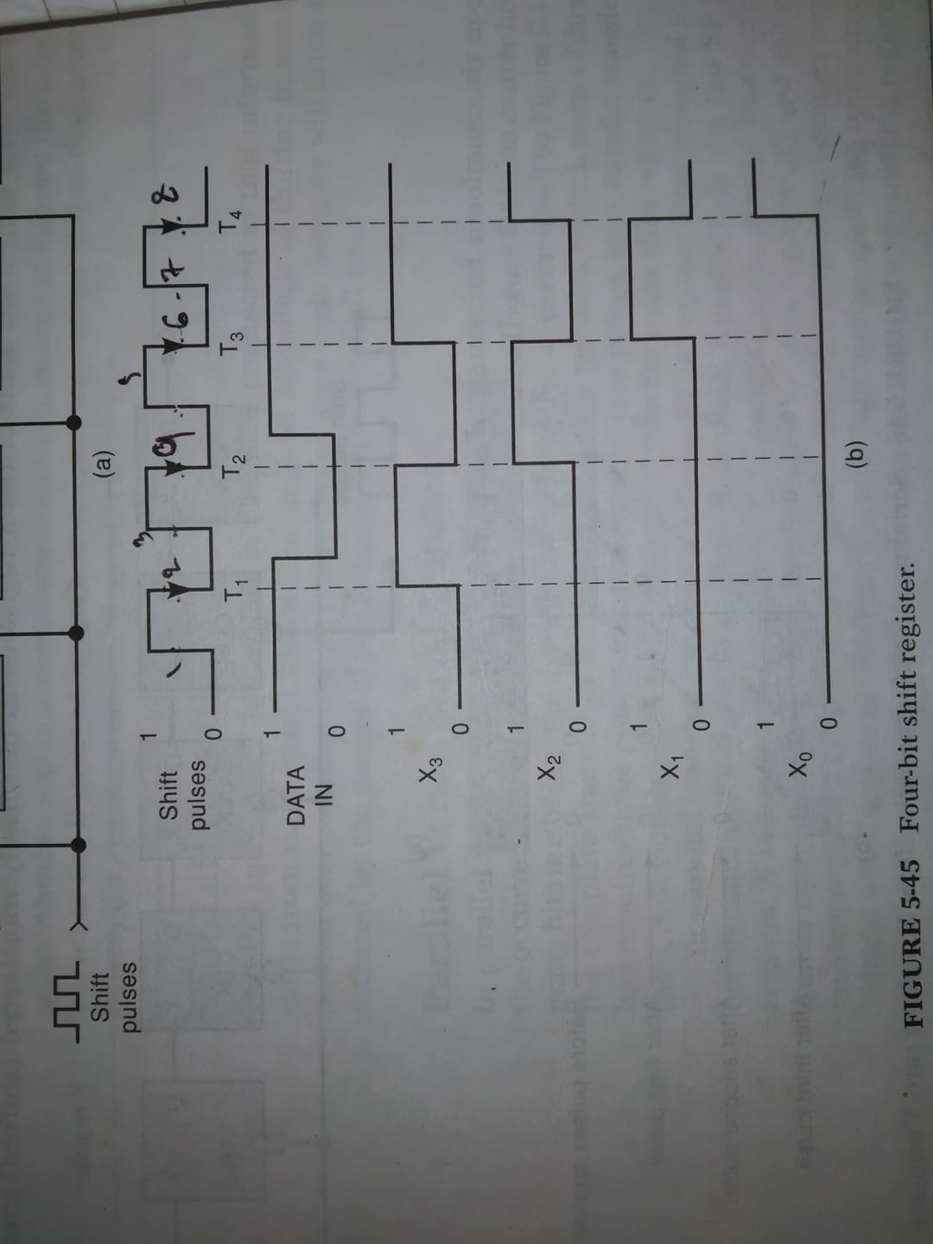
Data storage and transfer (serial data transfer: shift registers)

Slide 20
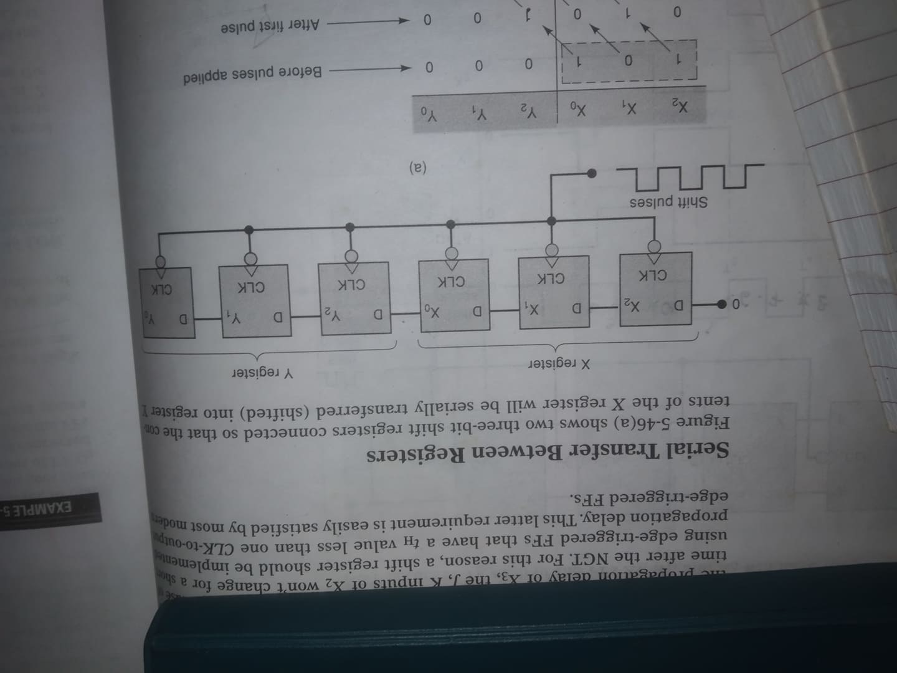
Data storage and transfer (serial data transfer between registers)

Slide 21
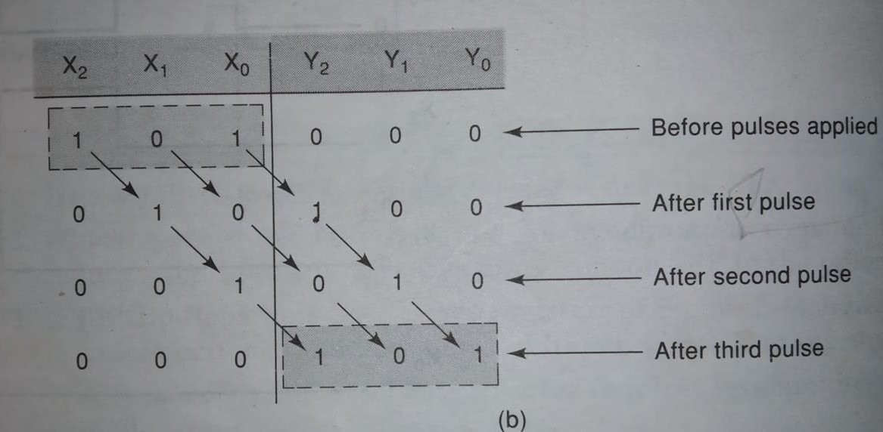
Data storage and transfer (serial data transfer between registers)

Slide 22
Frequency division and counting

Slide 23
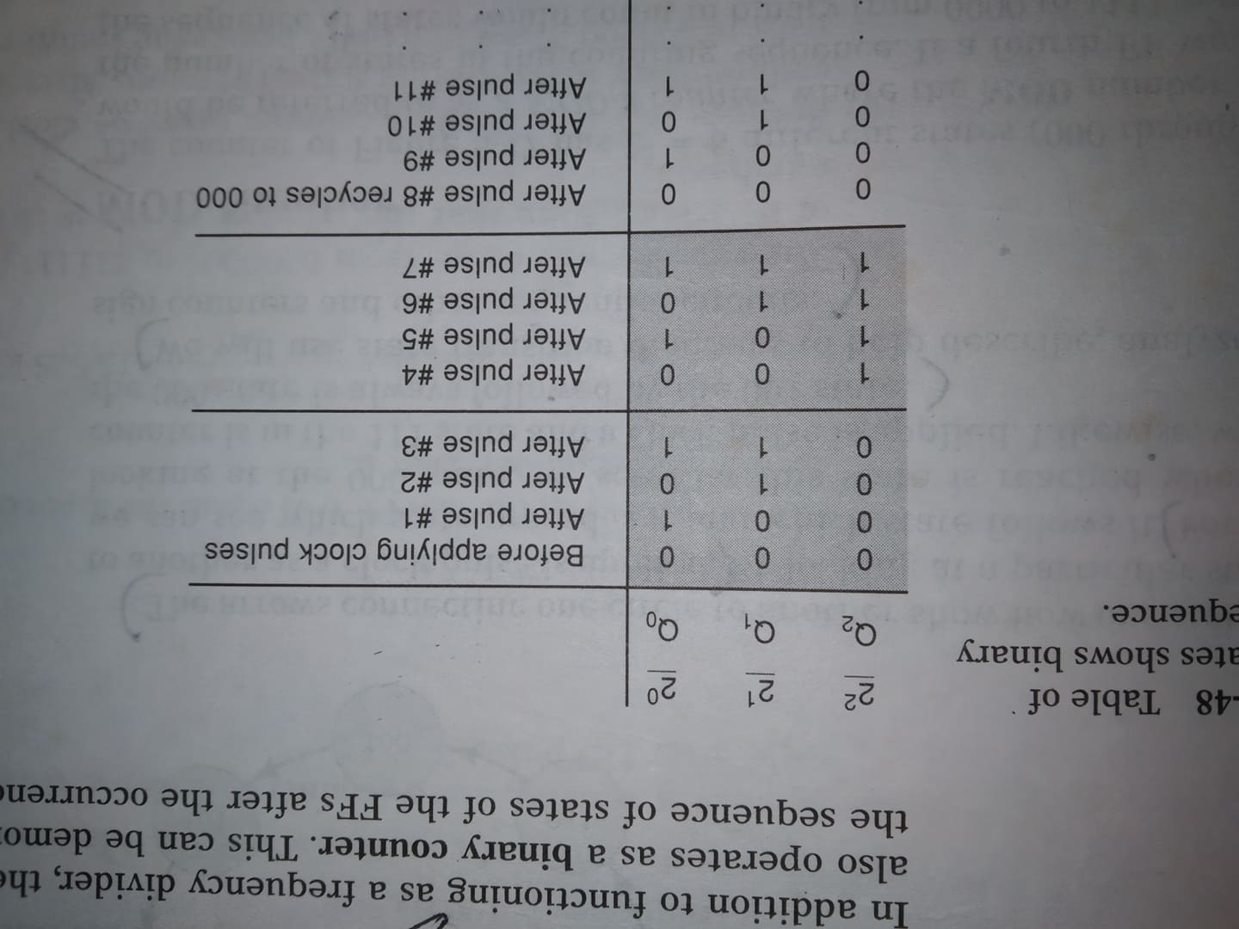
3 Bit binary counter (mod-8): counting operation

Slide 24
Frequency division and counting
Figure shows J-K FFs wired as a three bit binary counter. Each FFs J-K inputs are at 1 level i.e. toggle mode of operation. Only one direct NGT CLK is applied to Q₀ FF. Output Q₀ is connected to the CLK input of Q₁ and output Q₁ is connected to the CLK input of Q_{2.}

Slide 25
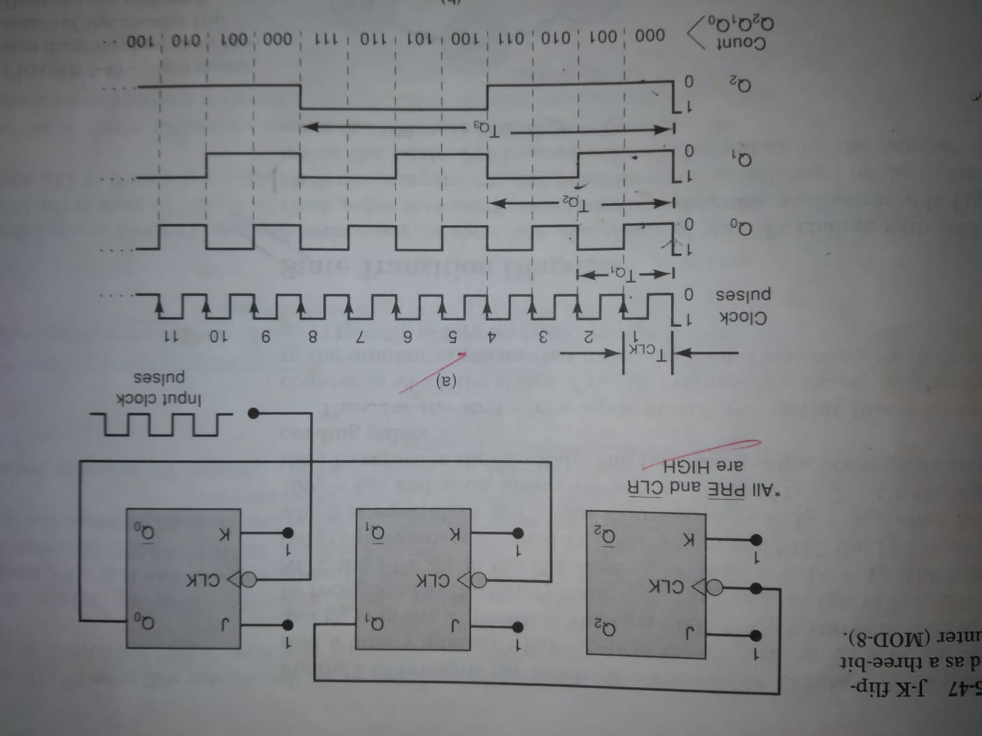
Frequency division and counting

Slide 26
Frequency division and counting
Q₀ toggles each input of CLK pulse. So output waveform has a frequency that is exactly one half of the clock pulse frequency.
Q₁ toggles each time of Q₀ output goes from HIGH to LOW. So output waveform has a frequency that is exactly one half of Q₀ output and therefore one fourth of the clock pulse frequency.
Q₂ toggles each time of Q₁ output goes from HIGH to LOW. So output waveform has a frequency that is exactly one fourth of Q₁ output and therefore one eighth of the clock pulse frequency.
Each FF output is a square wave (50% duty cycle).

Slide 27
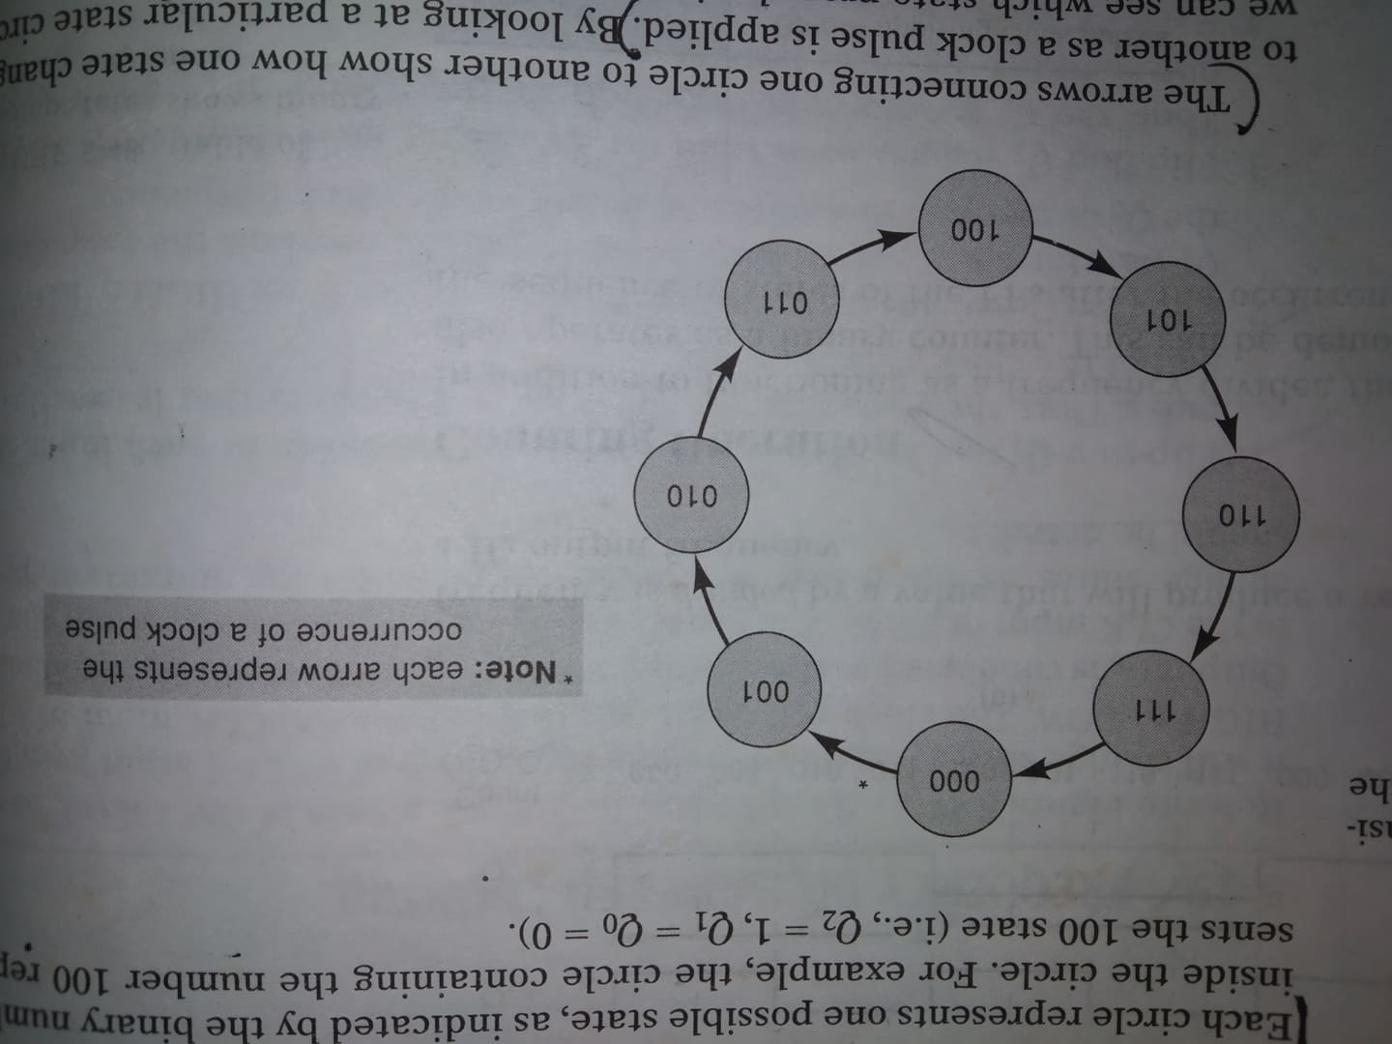
State transition diagram

Slide 28
Clock pulse generator

Slide 29
Astable Multivibrator Mode of 555 Timer IC
Astable multivibrator is also called as Free Running Multivibrator. It has no stable states and continuously switches between the two states without application of any external trigger. The IC 555 can be made to work as an astable multivibrator with the addition of three external components: two resistors (R_{A} and R_{B}) and a capacitor (C).

Slide 30
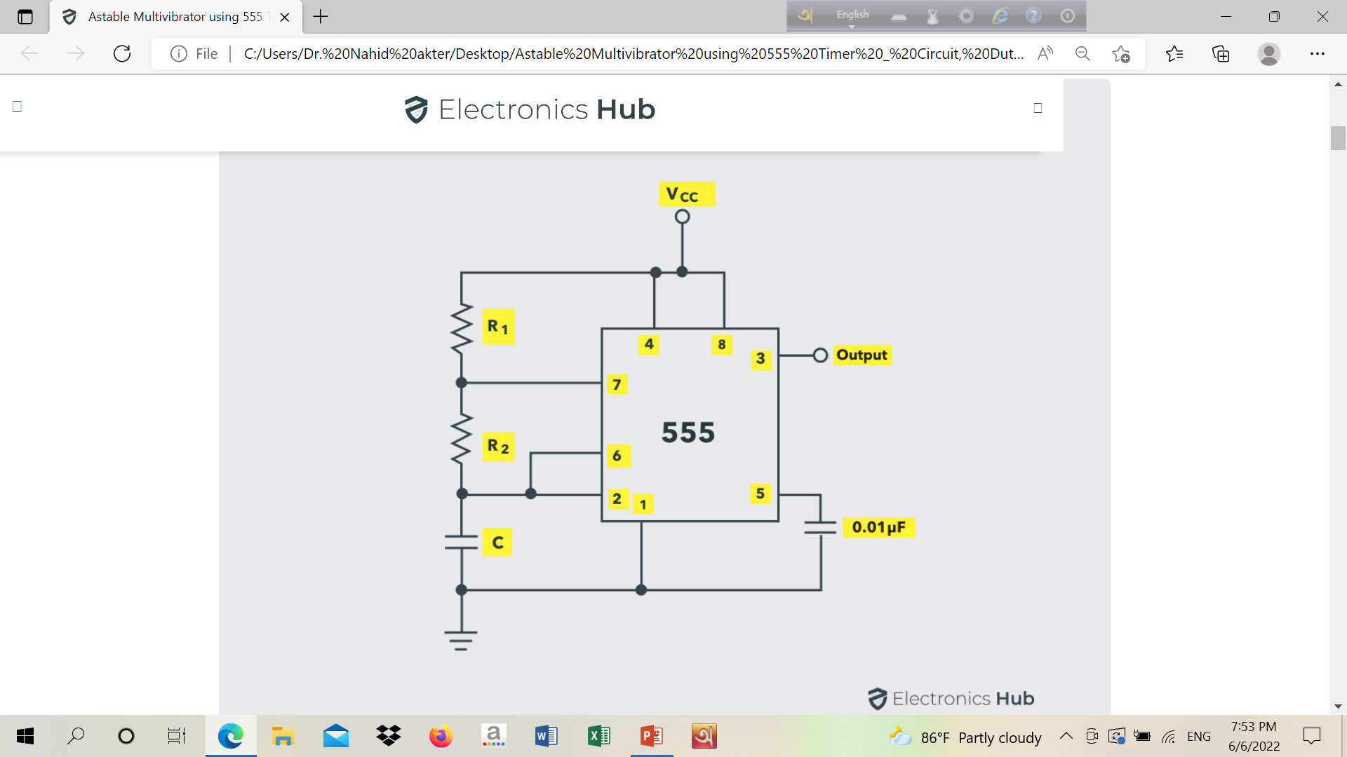
Astable Multivibrator Mode of 555 Timer IC

Slide 31
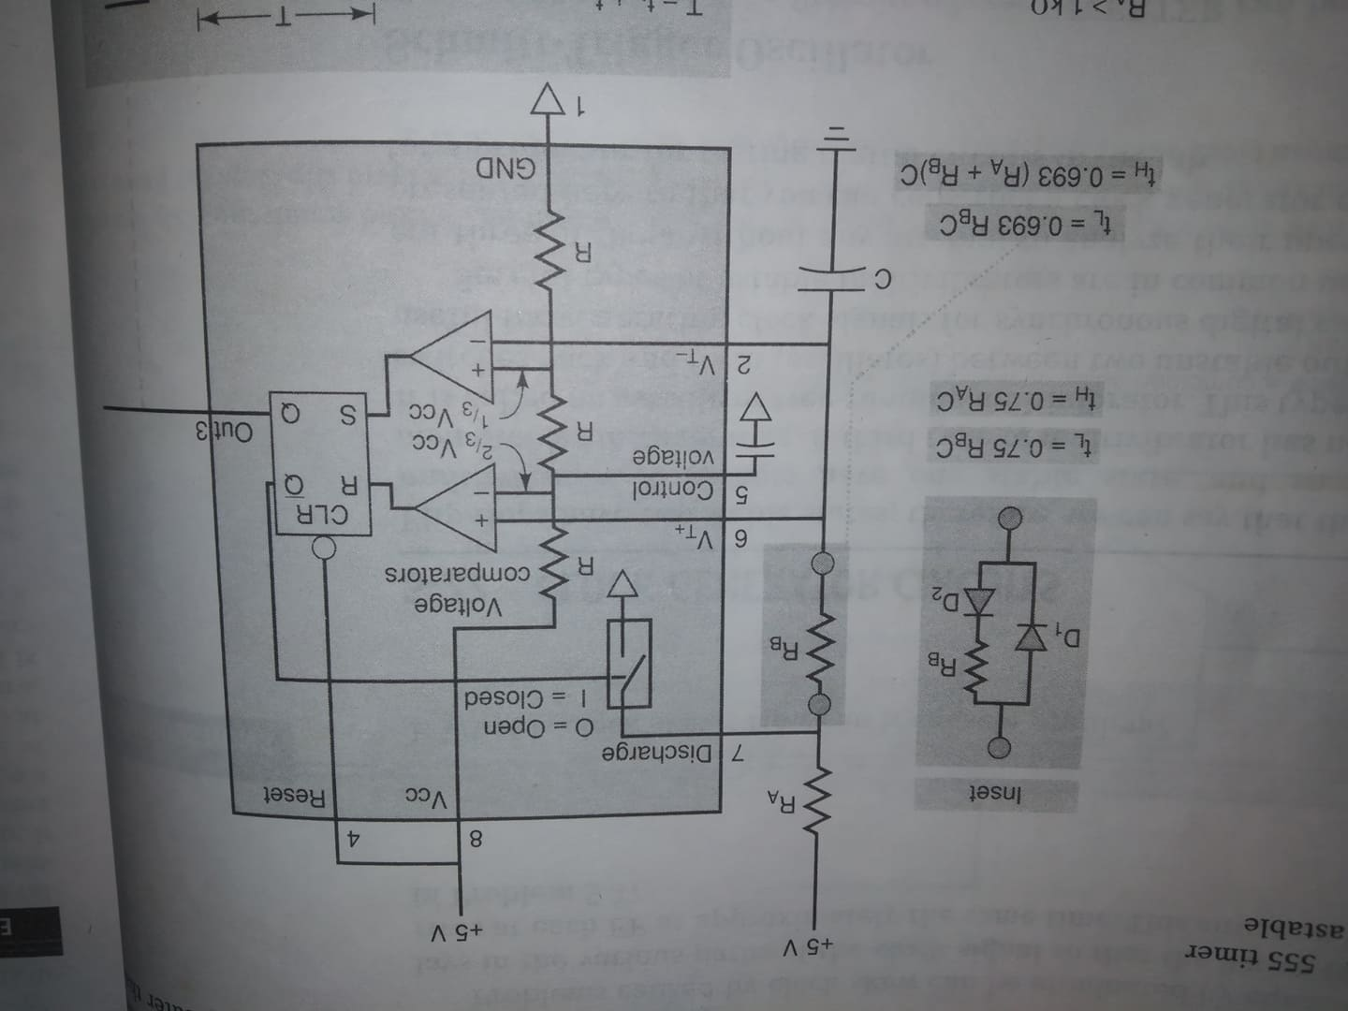
Astable Multivibrator Mode of 555 Timer IC

Slide 32

Astable Multivibrator Mode of 555 Timer IC
Initially, on power-up, the flip-flop is RESET (and hence the output of the timer is low). As a result, the discharge transistor is driven to saturation (as it is connected to $\overline{Q}$).The capacitor C of the timing circuit is connected at Pin 7 of the IC 555 and will discharge through the transistor. The output of the timer at this point is low. The voltage across the capacitor is nothing but the trigger voltage. So, while discharging, if the capacitor voltage becomes less than 1/3 V_{CC}, which is the reference voltage to trigger comparator (comparator 2), the output of the comparator 2 will become high. This will SET the flip-flop and hence the output of the timer at pin 3 goes to HIGH.

Slide 33
Astable Multivibrator Mode of 555 Timer IC
This high output will turn OFF the transistor. As a result, the capacitor C starts charging through the resistors R_{A} and R_{B}. Now, the capacitor voltage is same as the threshold voltage (as pin 6 is connected to the capacitor resistor junction). While charging, the capacitor voltage increases exponentially towards V_{CC} and the moment it crosses 2/3 V_{CC}, which is the reference voltage to threshold comparator (comparator 1), its output becomes high.
As a result, the flip-flop is RESET. The output of the timer falls to LOW. This low output will once again turn on the transistor which provides a discharge path to the capacitor. Hence the capacitor C will discharge through the resistor R_{B}. And hence the cycle continues.

Slide 34
Astable Multivibrator Mode of 555 Timer IC
Thus, when the capacitor is charging, the voltage across the capacitor rises exponentially and the output voltage at pin 3 is high. Similarly, when the capacitor is discharging, the voltage across the capacitor falls exponentially and the output voltage at pin 3 is low. The shape of the output waveform is a train of rectangular pulses.

Slide 35
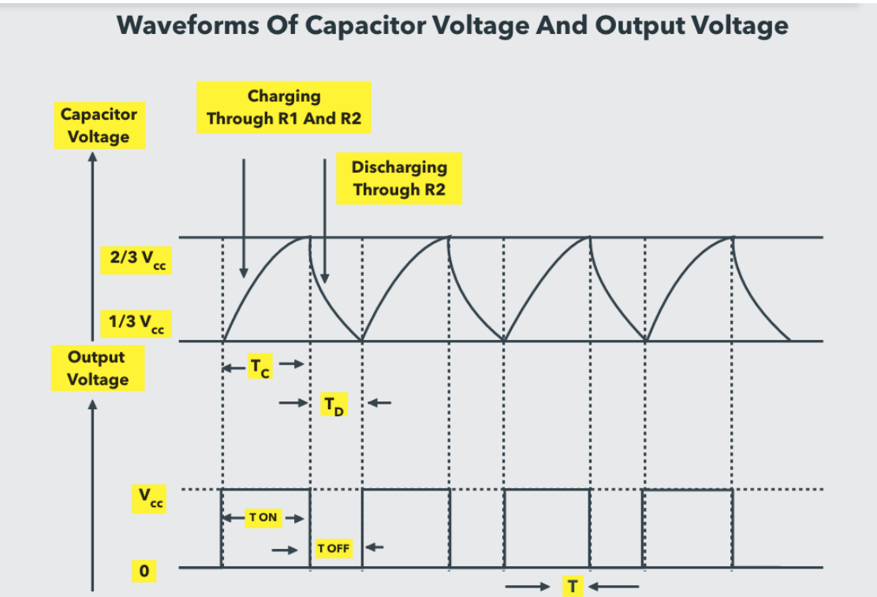
Astable Multivibrator Mode of 555 Timer IC

Slide 36
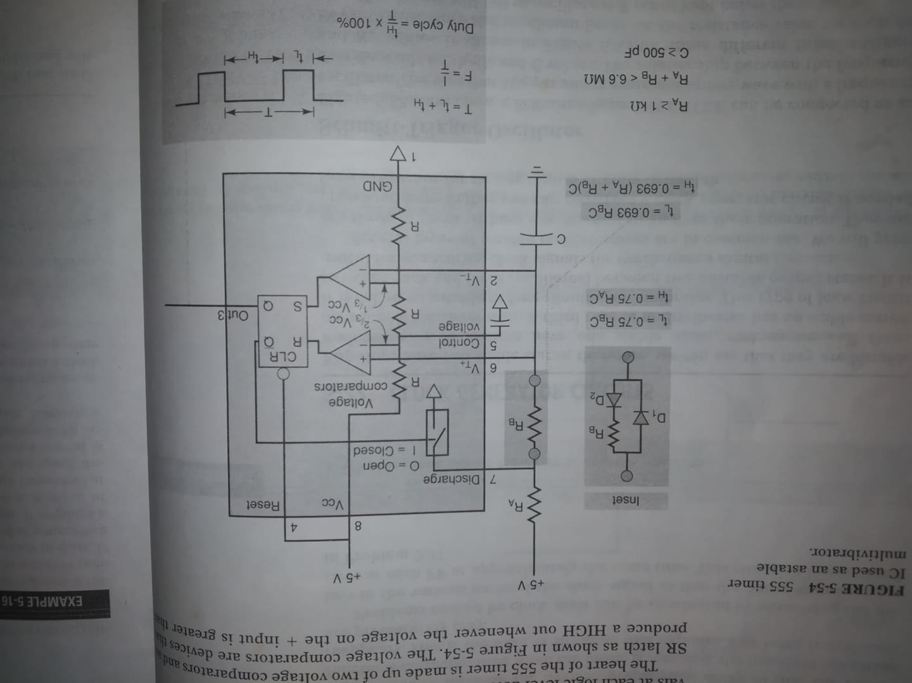
Astable Multivibrator Mode of 555 Timer IC

Slide 37
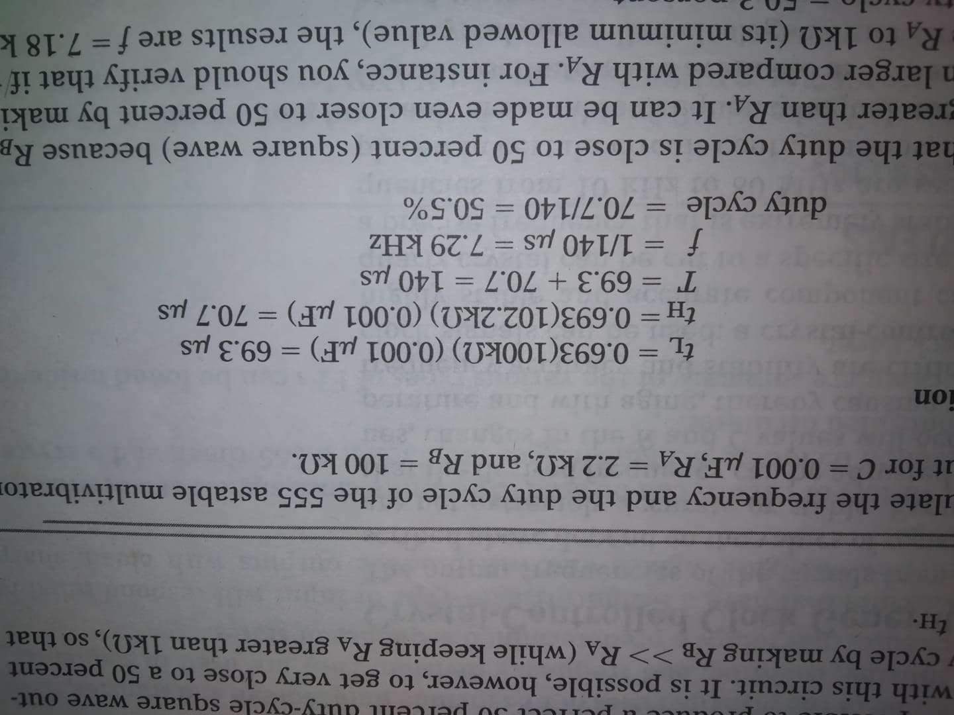

Example:
Calculate the frequency and the duty cycle of the 555 astable multivibrator output for C= 0.001 $μ$F, R_{A}= 2.2 k$Ω, RB=100$ k$Ω.$

